Slide 1
Cryptography: Diffie-Hellman & RSA Security Mechanisms
Justin Mendes

Slide 2
Outline
Cryptography
Private-Key/Symmetric Cryptography
Public-Key/Asymmetric Cryptography
Diffie-Hellman
RSA
Demo
Future Work
Conclusion

Slide 3
What is Cryptography?
Mathematical disorganization of data where only one person with the necessary key can reorganize it
Allows secure transmission of private information over insecure channels
Allows secure storage of sensitive data on any computer

Slide 4
Concepts of Cryptography
Encryption is converting plaintext into ciphertext
Decryption is converting ciphertext into plaintext
Cryptographic function - Mathematical function or algorithm used to encrypt/decrypt
Key - Parameter for a cryptographic function

Slide 5
Private-Key/Symmetric Cryptography
Traditional private-key/symmetric cryptography uses only one key
Shared by both sender and receiver
If this key is disclosed, communication is compromised
Both parties are equal

Slide 6
Private-Key/Symmetric Cryptography
Two people agree on an encryption method and a shared key
Sender uses the key and the encryption method to encrypt a message and sends it to the receiver
Receiver uses the same key and the related decryption method to decrypt the message

Slide 7
Advantages of Secret-Key/Symmetric Cryptography
Very fast classical encryption and decryption algorithm
Since the speed of a method varies with the length of the key, faster algorithms allow one to use longer key values
Larger key values make it harder to guess and break the key by brute force

Slide 8
Disadvantages of Secret-Key/Symmetric Cryptography
Requires secure transmission of key value
Requires a separate key for each group of people that wishes to exchange encrypted messages
Does not protect sender from receiver forging a message & claiming is sent by sender

Slide 9
Public-Key/Asymmetric Cryptography
Public-key/asymmetric cryptography involves the use of two keys:
Public-key - May be known by anybody, and can be used to encrypt messages
Private-key - known only to the receiver, used to decrypt messages
Impossible to determine private key from public
Asymmetric because the sender who encrypts messages cannot decrypt them

Slide 10
Public-Key/Asymmetric Cryptography
Uses two keys – a public and private key
Both parties are not equal
Uses application of number theoretic concepts to function
Complements rather than replaces private-key/symmetric cryptography

Slide 11
Public-Key/Asymmetric Cryptography
Sender generates a key value which is made public
Sender also uses their public key to determine a second key
Sender keeps their private key secret
Receiver can use sender’s public key to encrypt a message to them
Sender can use their private key to decrypt this message
No-one without access to the sender’s private key can easily decrypt the message

Slide 12
Why Public-Key/Asymmetric Cryptography?
Developed to address two key issues:
Key distribution – How to have secure communications in general without having to trust a key distribution center (KDC) with your key
Digital signatures – How to verify a message comes intact from the claimed sender

Slide 13
Public-Key/Asymmetric Cryptography Applications
Classified uses into 3 categories:
Encryption/decryption - Provides secrecy
Digital signatures - Provide authentication
Key exchange - of session keys

Slide 14
Public-Key/Asymmetric Cryptography Requirements
Public-key algorithms rely on two keys where they are:
Computationally impossible to find decryption key knowing only algorithm and encryption key
Computationally easy to encrypt/decrypt messages when the relevant key is known
Either of the two related keys can be used for encryption, with the other used for decryption

Slide 15
Public-Key/Asymmetric Cryptography Requirements
Need a trapdoor one-way function
One-way function has
x = f(x) easy
x = f^(–1)(y) impossible
A trap-door one-way function has
y = fk(y) easy if k and x are known
x = fk^(–1)(y) easy if k and y are known
x = fk^(–1)(y) impossible if y known but k not known
A practical public-key scheme depends on a suitable trap-door one-way function

Slide 16
Diffie-Helman Algorithm
1976: W. Diffie and M.E. Hellman proposed the first public-key encryption algorithms
An algorithm for public exchange of a private-key
Diffie-Hellman key agreement protocol
Exponential key agreement
Allows two users to exchange a secret key
Requires no prior secrets
Real-time over an untrusted network

Slide 17
Diffie-Helman
Security of transmission is critical for many network and Internet applications
Requires users to share information in a way that others can’t decipher the flow of information
Based on the difficulty of computing discrete logarithms of large numbers
Requires two large numbers, one prime (p), and a primitive root of p (g)

Slide 18
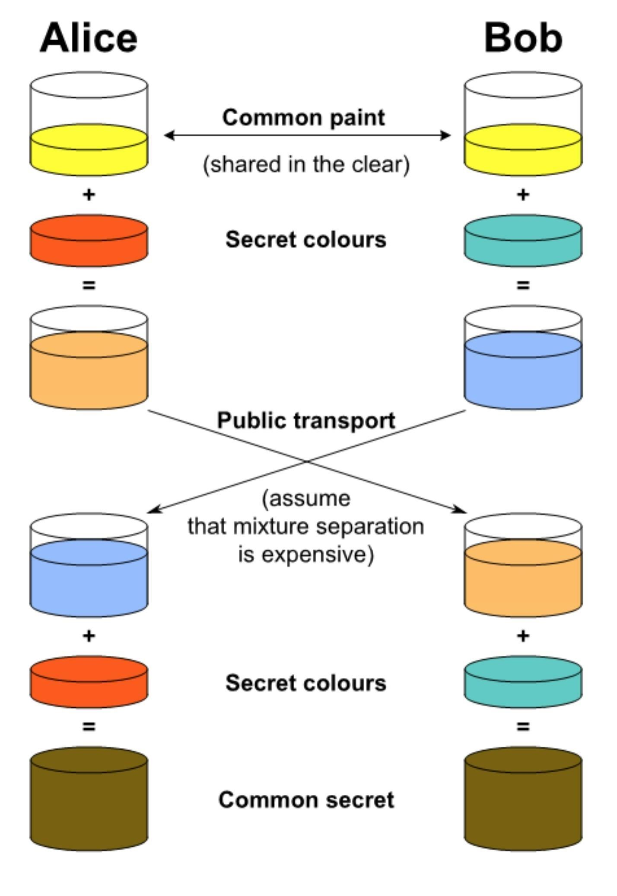
Diffie-Hellman Implementation
p and g are both publicly available numbers
Users pick private values a and b
Compute public values
x = g^a mod p
y = g^b mod p
Public values x and y are exchanged
Compute shared, private key
ka = y^a mod p
kb = x^b mod p
Algebraically it can be shown that ka = kb
Users now have a symmetric secret key to encrypt

Slide 19
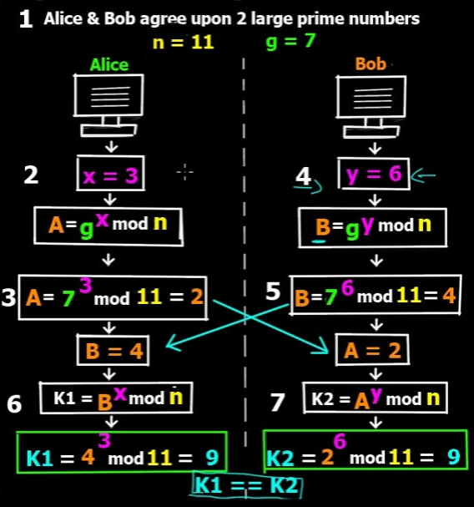
Diffie-Hellman Example
Two users, Alice and Bob wish to have a secure conversation
Alice and Bob get public numbers
n = 11, g = 7
Alice and Bob compute public values
a = 7^3 mod 11 = 343 mod 11 = 2
b = 7^6 mod 11 = 117649 mod 11 = 4
Alice and Bob exchange public numbers
Alice and Bob compute symmetric keys
ka = 4^3 mod 11 = 64 mod 11 = 9
kb = 2^6 mod 11 = 64 mod 11 = 9
Alice and Bob now can talk securely!

Slide 20
Diffie-Hellman Applications
Diffie-Hellman is currently used in many protocols, namely:
Secure Sockets Layer (SSL)/Transport Layer Security (TLS)
Secure Shell (SSH)
Internet Protocol Security (IPsec)
Public Key Infrastructure (PKI)

Slide 21
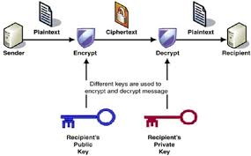
RSA (Rivest, Shamir, Adleman) Algorithm
1978: L.M Adleman, R.L. Rivest and A. Shamir propose the RSA encryption method
Currently the most widely used
Uses a random process to select two large prime numbers p and q
Computes the product m = p * q
M is the modulus and is made publicly available
Also computes the Euler totient t = (p - 1) * (q - 1)
This number, as well as p and q, are kept secret.

Slide 22
RSA
Randomly choose a public key e that has no factors in common with t = (p - 1) * (q - 1)
Compute a private key d so that e * d leaves a remainder of 1 when divided by t
e * d is congruent to 1 modulus t
d is easy to compute only if a user knows the value of t
Essentially the same as knowing the values of p and q

Slide 23
RSA
If n is any number that is not divisible by m, then dividing n^9e * d) by m and taking the remainder yields the original value n
This is a relatively deep mathematical theorem, which we can write as n^(e *d) mod m = n.
If n is a numeric encoding of a block of plaintext, the cyphertext is c = n^e mod m.
Then c^d mod m = (n^e)d mod m = n^(e*d) mod m = n
User recover the plaintext n with the private-key d

Slide 24
RSA Encryption/Decryption
To encrypt a message m, the sender:
Obtains public key of recipient pu = {e,n}
Computes: c = m^e mod n, where 0 ≤ m<n
To decrypt the ciphertext c the owner:
Uses their private key pr = {d,n}
Computes: m = c^d mod n
Message m must be smaller than the modulus n

Slide 25
RSA Key Generation
Users of RSA must:
Determine two primes at random (p, q)
Select either e or d and compute the other
Primes p, q must not be easily derived from modulus n = p * q
Means must be sufficiently large
Typically guess and use probabilistic test
Exponents e and d are inverses, so use Inverse algorithm to compute the other

Slide 26
RSA Key Setup
Each user generates a public/private key pair by:
Selecting two large primes at random: p, q
Computing their system modulus n = p * q
note ø(n) = (p-1) * (q-1)
selecting at random the encryption key e
where 1 < e < ø(n), gcd(e,ø(n)) = 1
solve following equation to find decryption key d
e* d = 1 mod ø(n) and 0 ≤ d ≤n
Publish their public encryption key: PU = {e,n}
Keep secret private decryption key: PR = {d,n}

Slide 27
RSA Example: Key Setup
Select primes: p = 17 & q = 11
Calculate: n = p * q = 17 x 11 = 187
Calculate: ø(n) = (p – 1) * (q - 1) = 16 * 10 = 160
Select e: gcd(e, 160)=1; choose e = 7
Determine d: d * e=1 mod 160 and d < 160 Value is d = 23 since 23 * 7 = 161 = 10 *160 + 1
Publish public-key PU = {7,187}
Keep secret private-key PR = {23,187}

Slide 28
RSA Key Setup
Each user generates a public/private key pair by:
Selecting two large primes at random: p, q
Computing their system modulus n = p * q
note ø(n) = (p-1) * (q-1)
selecting at random the encryption key e
where 1 < e < ø(n), gcd(e, ø(n)) = 1
solve following equation to find decryption key d
e* d = 1 mod ø(n) and 0 ≤ d ≤n
Publish their public encryption key: PU = {e,n}
Keep secret private decryption key: PR = {d,n}

Slide 29
RSA Example: Encryption/Decryption
Sample RSA encryption/decryption is:
Given message m = 88 (nb. 88 < 187)
Encryption:
c = 887 mod 187 = 11
decryption:
m = 1123 mod 187 = 88

Slide 30
Why RSA Works
Euler's Theorem:
A^(ø(n)) mod n = 1 where gcd(a, n) = 1
RSA has:
n = p * q
ø(n) = ( p - 1) * (q - 1)
Carefully chose e and d to be inverses mod ø(n)
e * d = 1 + k * ø(n) for some k
Therefore:
C^d = M^(e * d) = M^1 + k * ø(n)) = M^1 * (M^(ø(n))k)) = M^1 * (1)^k = M^1 = M mod n

Slide 31
Why RSA Works
Multiplying p by q is easy - The number of operations depends on the number of bits in p and q
If someone knows M, finding p and q is hard - In essence, the number of operations depends on the value of M
No one has found a quick algorithm for factoring a large number M.
No one has proven that such a quick algorithm does not exist

Slide 32
Demo

Slide 33
Future Work
Implement two user communication on a server
Encrypt files of different formats into cyphertext
Automate and randomize public and private key generation and setup

Slide 34
Conclusion
Cryptography - Mathematical disorganization of data where only one person with the necessary key can reorganize it
Private-Key/Symmetric Cryptography - uses only one key shared by both sender and receiver. If key is disclosed, communication is compromised
Public-Key/Asymmetric Cryptography Uses two keys (public and private key) where both parties are not equal. Complement keys rather than replacing private-key
Diffie-Helman Algorithm - Requires users to share information in a way that others can’t decipher the flow of information and requires two large numbers, one prime (p), and a primitive root of p (g)
RSA - Currently the most widely used. Uses a random process to select two large prime numbers p and q to computes the product m = p * q and the Euler totient t = (p - 1) * (q - 1)

Slide 35
Questions?

